Slide 1
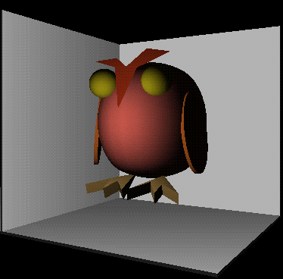
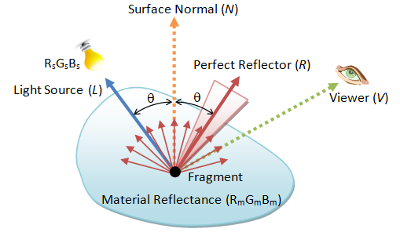
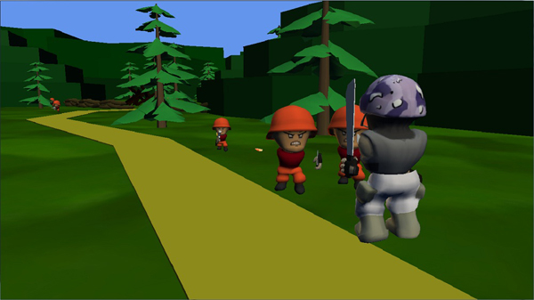
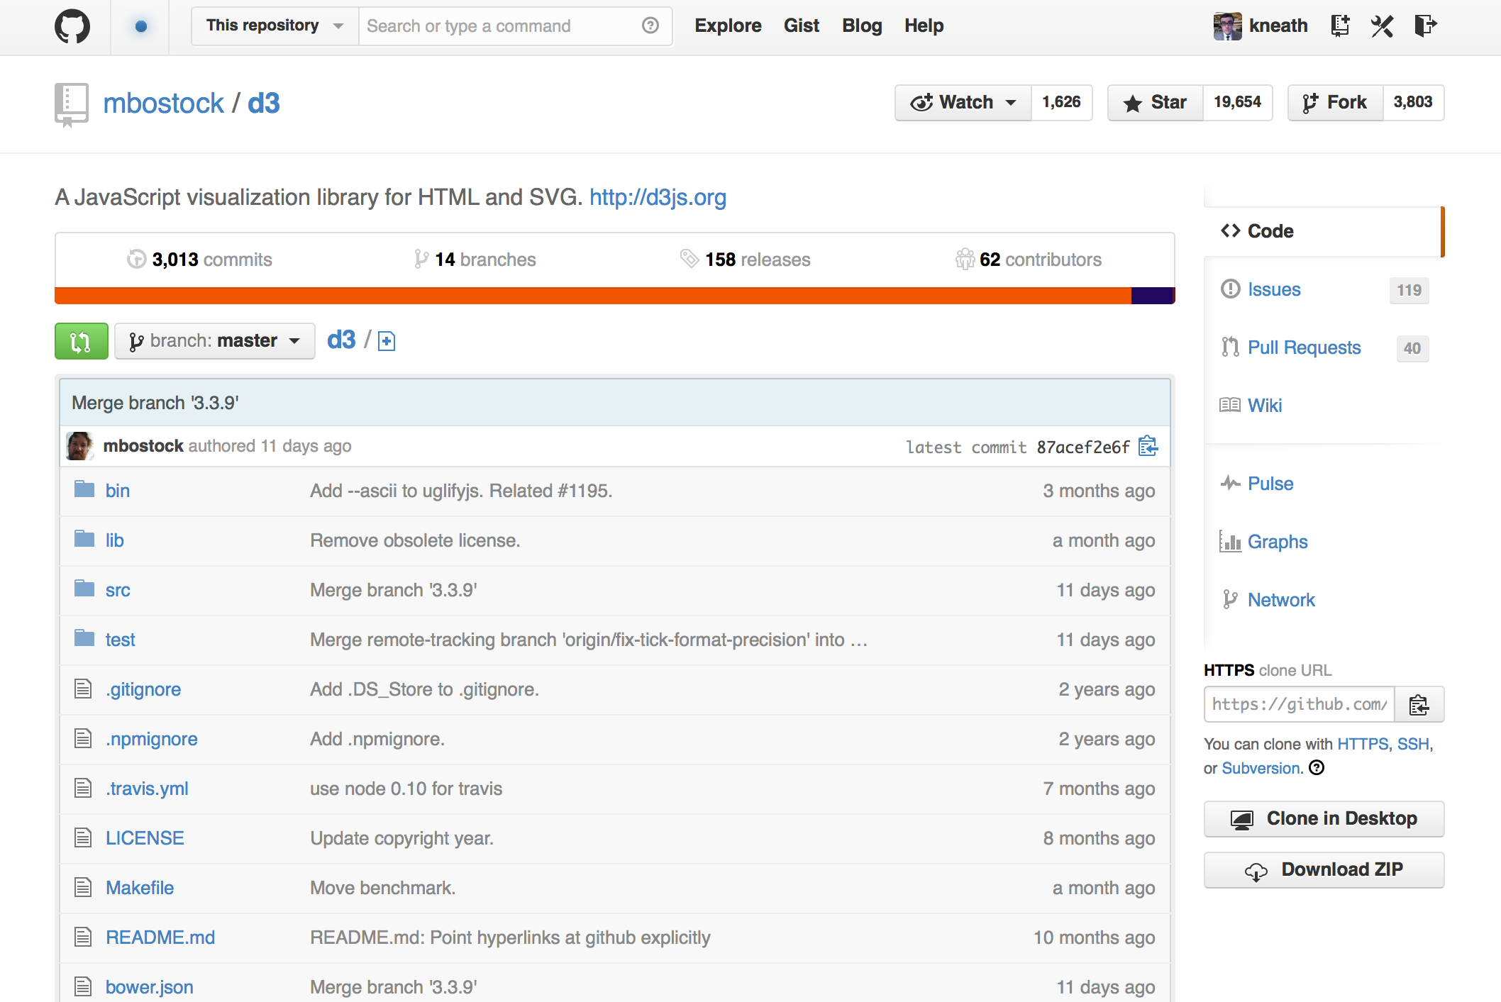
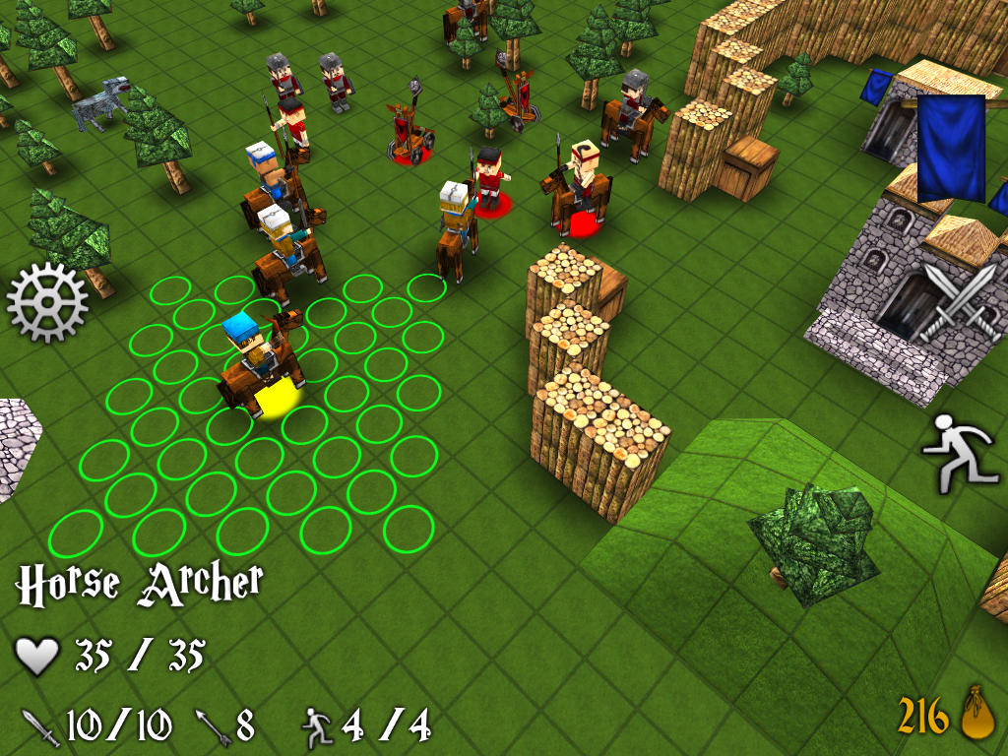
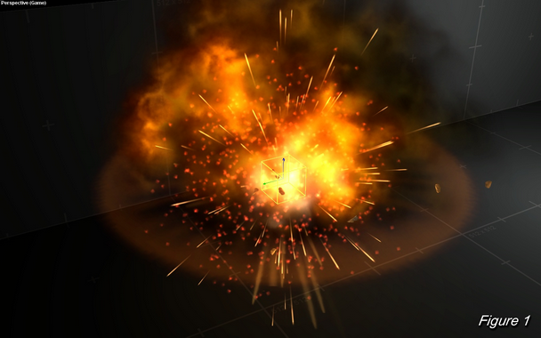

Introduction
Advanced Games Programming (CGP600)

Slide 2
Overview
First off – Please remember to SWIPE IN !!!!
What this module is NOT:
Graphics Modelling
Learning/Working with pre-built engines
Module WILL include:
3D maths and techniques (Remember Physics?)
OOP (C++) and Direct X 11
Hands-on Practical Implementation (High-Performance Graphics, Memory management, Pointers, Optimisation Considerations)
Focus on Software Design, Algorithms and Implementation
Software Techniques (emphasis on an interactive game to demonstrate your understanding of concepts)

Slide 3
Activity 1
What do we mean by software design? Start thinking about a game you’d like to write, what would be the main components for your game and why?
For example
Graphics
Particles
Artificial Intelligence
Rigid Body Dynamics (e.g., cloth, collisions)
Constraints (e.g., ragdolls)
Fur/Hair
Fracturing/ Smashables (yes, that’s a word… honest)

Slide 4
About Advanced Games Programming
The process of designing and developing a video game from the ground up
Learn essential concepts common in video games, software engineering, medical software,...
Enormous software engineering challenges
Create demonstrate various techniques during the unit
Graphics, Particles, Object Orientated Design, Collision, ...

Slide 5
Unit Aims
Gain experience in developing in managing a complex project while learning core game components, particularly the technical aspects (e.g., 3-dimensional graphics, real-time performance, stability, ..)
Put together various gaming elements
Examine some of the fundamental techniques used in game development, such as, the underpinning maths, graphics, performance bottlenecks, particles, collisions...

Slide 6
Structure – Lectures/ Practicals
Formal lecture followed by a practical tutorial session
Attendance is mandatory at all sessions – remember to SWIPE IN!
Practical Lab Sessions:
Takes place in the Games Lab (JM311/JM306)
Work on developing the supporting games development concepts
C++
Writing clear, computationally fast, elegant code
Visual Studio
More than just a glorified editor
Use additional features (profiler)
Version Control
GitHub or Mercurial (more than just an online hard drive)

Slide 7
Practical Lab sessions continued..
This is all about exploring and extending solutions to tutorials you have done beforehand in your own time
You are responsible for making a credible attempt at the work.
We are happy to help you if you attempt it and are struggling, but you have to show/explain what you’ve tried
I think it’s a good idea to point out now that the extra/advanced exercises are where you will do most of the real learning and therefore it’s a really good idea to at least attempt these
I will be regularly checking how many commits you make on version control and will use this as an indication of engagement (so long as the work is actually done!!)

Slide 8
Working Through the Tutorial Practicals
Regularly check in your work to GitHub/Mercurial (did I mention that?…)
I can help with getting you set up if you need it
Make videos of your working practical simulations (good habits)
put the course title, title of your demo and your name at the start of the video
Write modular readable code
Experiment – and try different things (remember the extra/advanced stuff?)
Challenging but you should remember to have fun and enjoy the unit!

Slide 9
Work Plan
You WILL have to work around 8+ hours a week on the module
4 hours contact (lectures and practicals)
4 hours self study (seriously, this is a bare minimum)
Coursework will require some organisation outside class time
Use the Games Lab – it’s what it is there for
Keep up with practical work!
We won’t be pausing – so falling behind at any stage means it will be difficult to catch up

Slide 10
Focus of the Module
Game framework design
Initially we will focus on different technical game mechanics and show how we can use these in real-world situations
Software modelling
Applying common modelling techniques to games development
Games mechanics
Develop the underlying rules and procedures for games system
Software development
Design and modelling, and mechanistics of different games
Watching games
Yes, you will have to watch and play games. However, you will start to analyse game-workings more closely and understand what is happening within them

Slide 11
Problems
ALWAYS come to lectures. ALWAYS attempt the work.
Even If you are struggling, bring your work and your notes on the problems encountered and how you tried to resolve them.
We can’t help you if we can’t see what you tried.
DON’T just not turn up if you’re struggling.
It’s the worst thing you can do – Problems will quickly accumulate to a point that’s difficult to recover from.
Got a problem? Come talk to us as soon as possible. We’re friendly and approachable and catching it early is the best way to sort it out quickly.

Slide 12
Academic Misconduct
You are encouraged to help each other – it’s a great way to learn!
However, be careful how you do it:
Stick to verbal explanations
Encourage thinking – don’t just give the answer.
Never ever share work, especially source code.
Work that has been copied is called collusion
Both the person that copied and the person copied from are equally liable.
Read the chapter on academic misconduct in the student handbook very carefully, and ask if you’re not sure

Slide 13
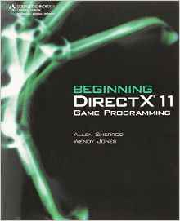


Recommended Reading
Sherrod, A. and Jones, W. (2011), Beginning DirectX 11 Game Programming. Course Technology, Cengage Learning. (ISBN: 978-1435458956)
Dunn, F. and Parberry, I. (2002), 3D Math Primer for Graphics and Game Development. Wordware Publishing Inc, US (ISBN: 978-1568817231)
Frank D. Luna, (2016), Introduction to 3D Game Programming with DirectX12 (Computer Science) Paperback (ISBN: 978-1942270065)

Slide 14

Recommended Reading
Tomas Akenine-Möller et al. Real-Time Rendering, Third Edition Hardcover (2008). (ISBN: 978-1568814247)
Students are expected to read around the subject in order to solidify their understanding of the material and help them complete on-going assessments/courseworks and classroom activities.

Slide 15
Contacting the Unit Leader
Contact details:
Philip.alassad@solent.ac.uk
JM505
Open door policy
Come along and see me whenever – but try not to exploit it
The best time to ask for help is during the practical sessions
Try the practical before the class, and then ask for clarification during the practical

Slide 16
Summary
Start early
Practical sessions
Demonstrate both theoretical and practical technical ability
through implementation
technical report (i.e., citations, equations, formatting, mechanics, )
8+ hours self-study (remember that this is a minimum)

Slide 17
To do this week…
Read over the lectures
Practicals
Challenging – hence, start early
Setup source control – (i.e., Github)
Work through tutorial practicals
Guide 01, 02, Tutorial 01, …
Experiment (get into good habits)

